Slide 1


Air Aware Smart Air Quality Prediction System
AirAware 🌤️ is a real-time air quality monitoring and prediction system. It shows live AQI data for major cities and uses an LSTM model to forecast PM2.5 levels. The interactive Streamlit dashboard helps users visualize pollution trends and make informed decisions about air quality.

Slide 2
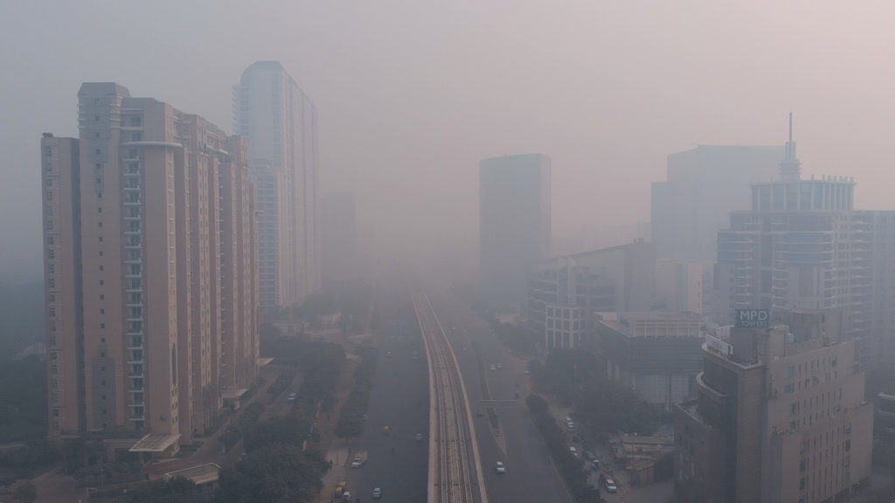
Problem Statement:
Air pollution is a growing concern in urban environments, directly impacting human health and environmental quality. Accurate forecasting of air quality can help authorities take preventive measures, issue warnings, and inform the public. This project aims to build a time series forecasting system that predicts air quality index (AQI) and pollutant levels using historical pollution data. The goal is to empower environmental agencies, city planners, and the public with timely insights for healthier decision-making.

Slide 3
Solution Objectives:
• A time series forecasting model to predict AQI and key pollutants (PM2.5, PM10, NO2, etc.).
• Visual dashboard showing historical trends and future air quality predictions.
• Alerts or warnings when predicted AQI crosses safety thresholds.
• Ability to analyze pollutant contributions and seasonal trends.
• Admin functionality to upload new datasets and retrain models for updated forecasting.

Slide 4







Tech Stack:
This Photo by Unknown Author is licensed under CC BY-SA-NC

Slide 5
Data Sources
AQICN API (real-time)
Historical AQI datasets (CSV files)
Pollutant features: PM2.5, PM10, O₃, NO₂, SO₂, CO
Target: AQI value

Slide 6
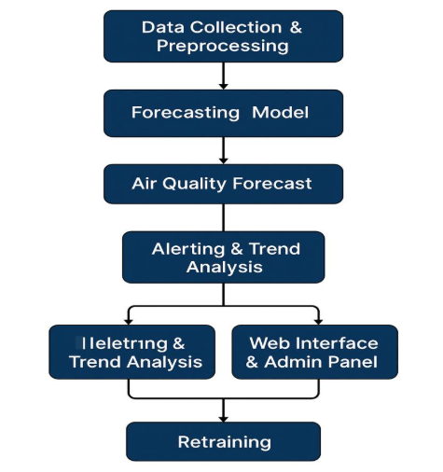
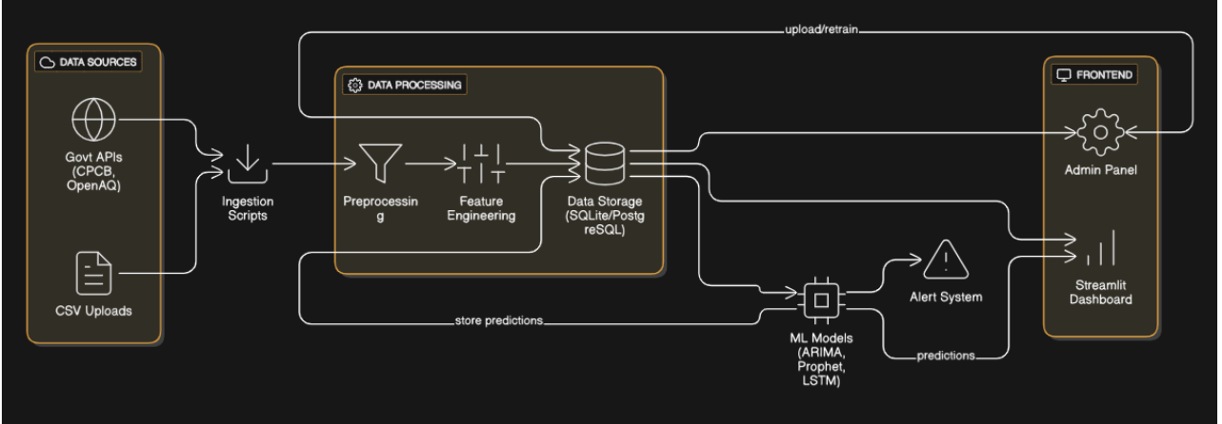
Methodology:
Work Flow / Process Diagram:
Architecture Diagram:

Slide 7
Models Used:
Artificial Neural Networks
Decision Tree Regressor
Random Forest Regressor
Xgboost Regressor
Ridge and Lasso Regression
K-nearest neighbors Regression
Linear Regression
Long Short Term Memory (LSTM)

Slide 8
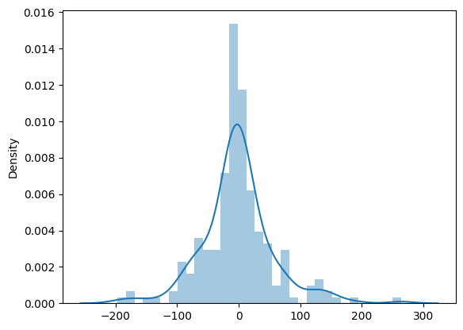
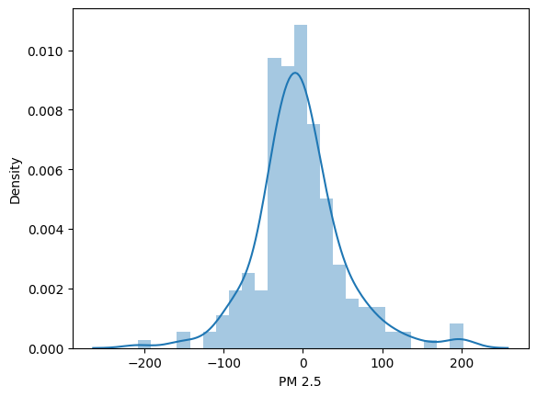
Results: Models Comparison over the metrics and predictions
Artificial Neural Networks
Decision Tree Regressor

Slide 9
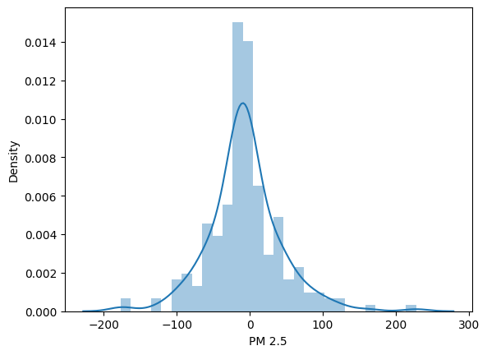
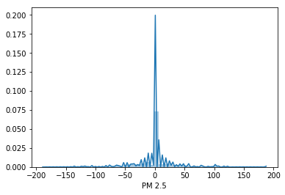
Results: Models Comparison over the metrics and predictions
Decision Tree Regressor
XG boost Regressor

Slide 10
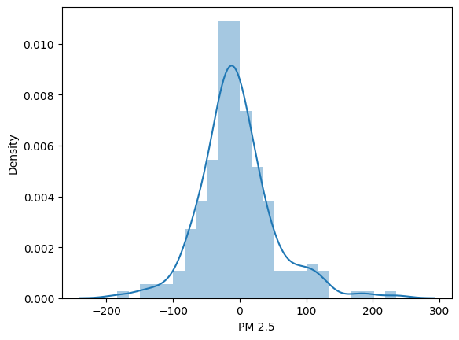
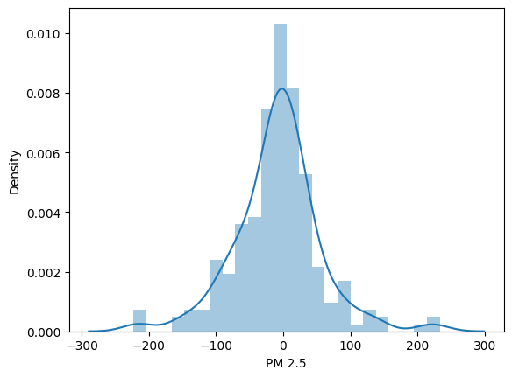
Results: Models Comparison over the metrics and predictions
Lasso Regression
KNN Regressor

Slide 11
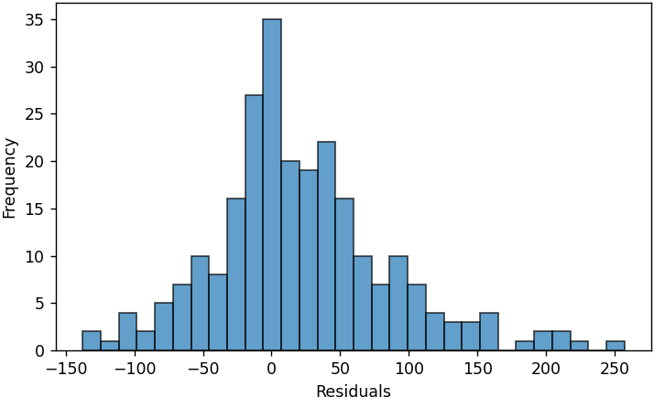
Results: Models Comparison over the metrics and predictions
LSTM Regression

Slide 12
Challenges:
API limitations (access tokens, data gaps)
Seasonal variability in pollution
Handling missing and inconsistent data
Scaling the model for multiple cities

Slide 13
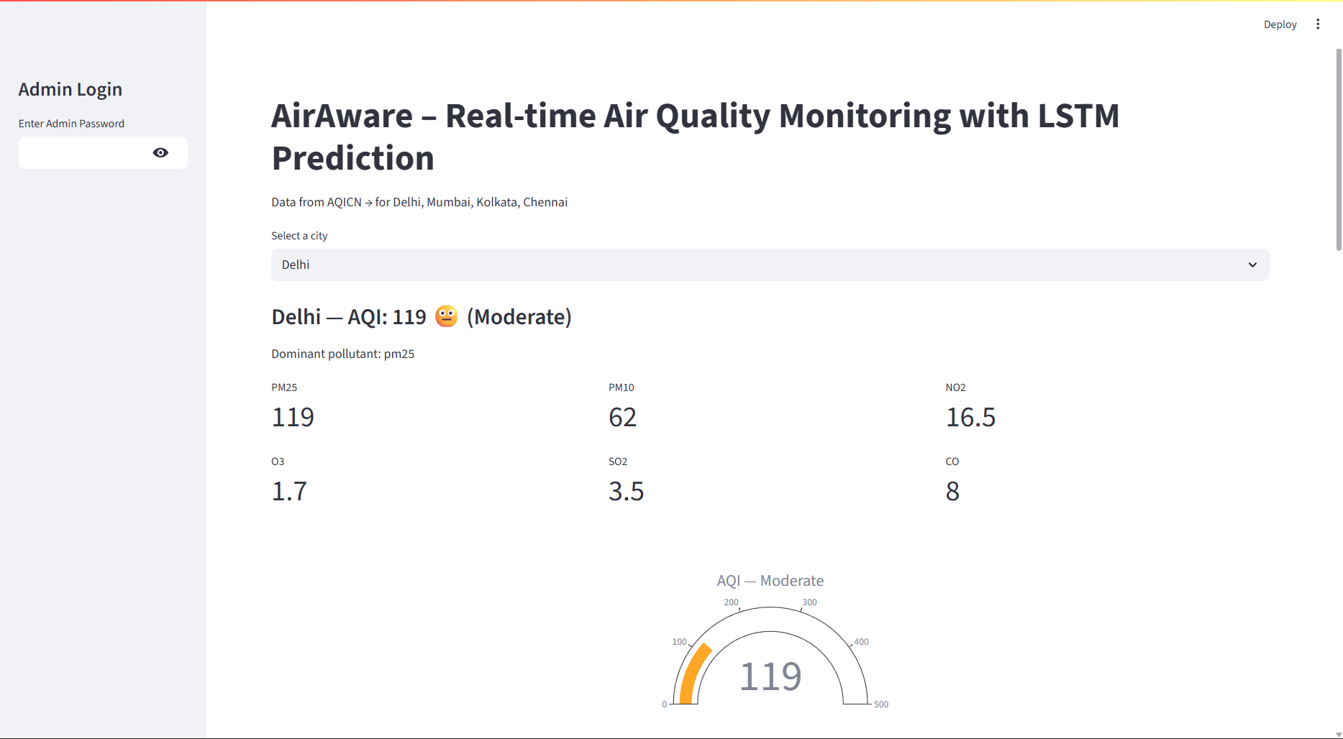
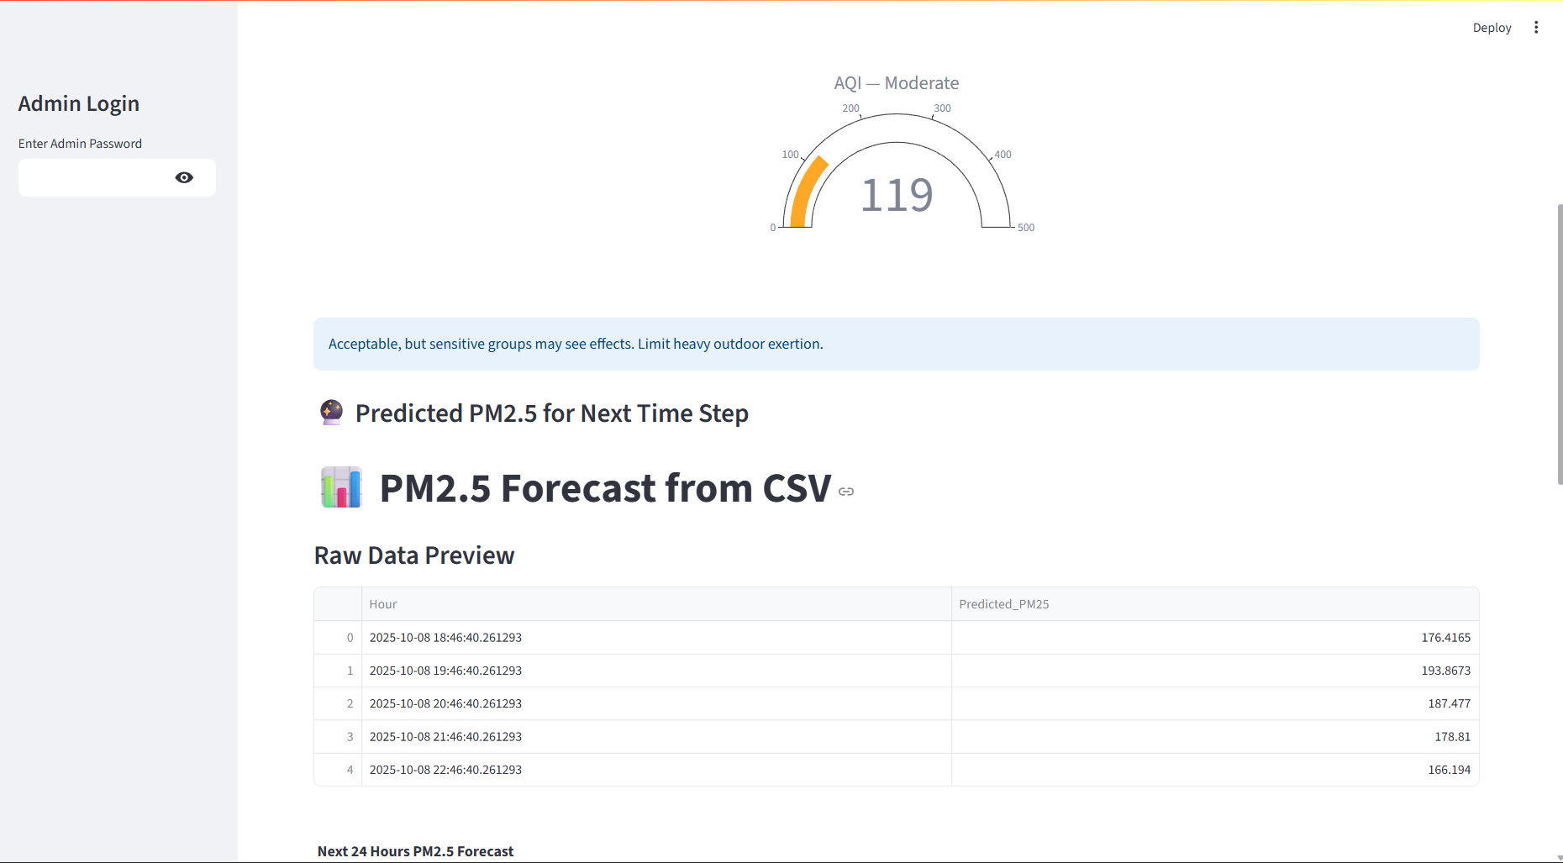
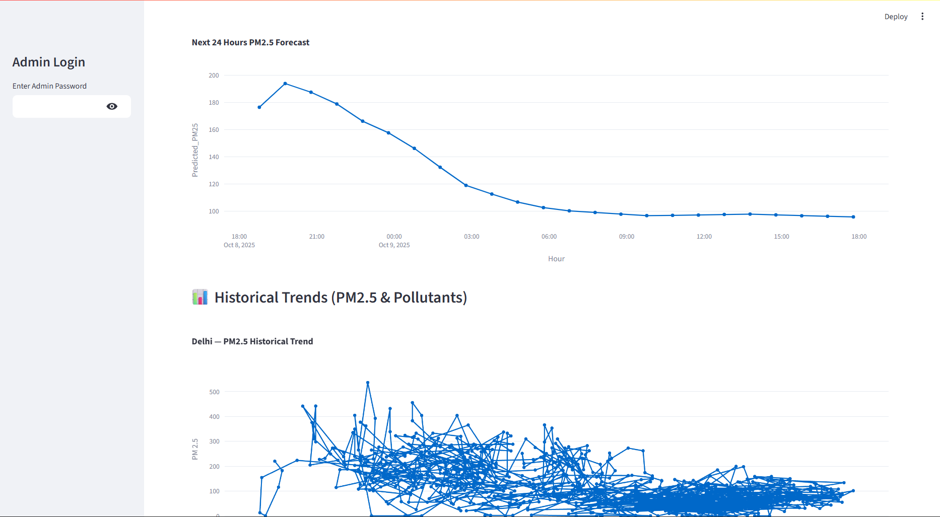
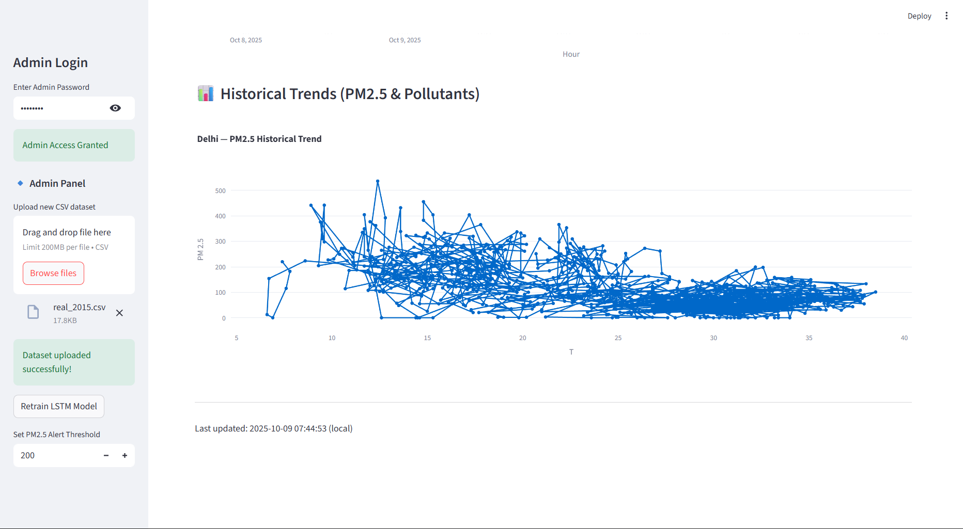
Dashboard:
LIVE AQI
LSTM PREDICTIONS
Prediction graph and Historical trends
Admin Panel and Retraining

Slide 14
Future Scope
Incorporate weather & traffic data for better prediction
Mobile app integration for citizen alerts
GIS mapping of pollution hotspots
Government policy recommendation system

Slide 15
Conclusion:
Air pollution remains one of the biggest threats to public health and environment.
Our project demonstrates that real-time monitoring + AI-driven forecasting can empower citizens, policymakers, and researchers.
By predicting pollution trends, we can move from reactive measures to proactive solutions.
AirAware is a step toward cleaner air, smarter cities, and a healthier future.

Slide 16
References:
AQICN, Kaggle Datasets - https://aqicn.org/here
Research papers on AQI forecasting - https://www.sciencedirect.com/science/article/pii/S004565352301785X
Github Link:
Providing the github link that contains all the code files
https://github.com/Parasuram2530/Infosys-Springboard.git

Slide 17
THANK YOU

